Slide 1
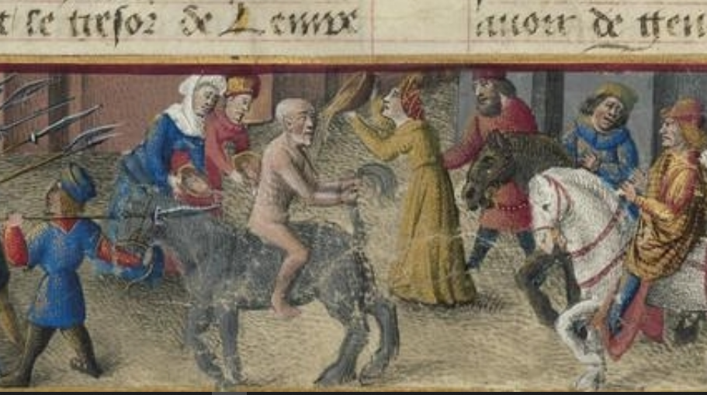
Andronicus Comnenus:
The Byzantine Trump
Sean Gabb, Friday the 15th September 2022

Slide 2
The Eastern Roman Empire, 565 AD
Cover image: Humiliation d'Andronikos, Sébastien Mamerot and Jean Colombe, Les passages d‘Outremer, 15th century

Slide 3
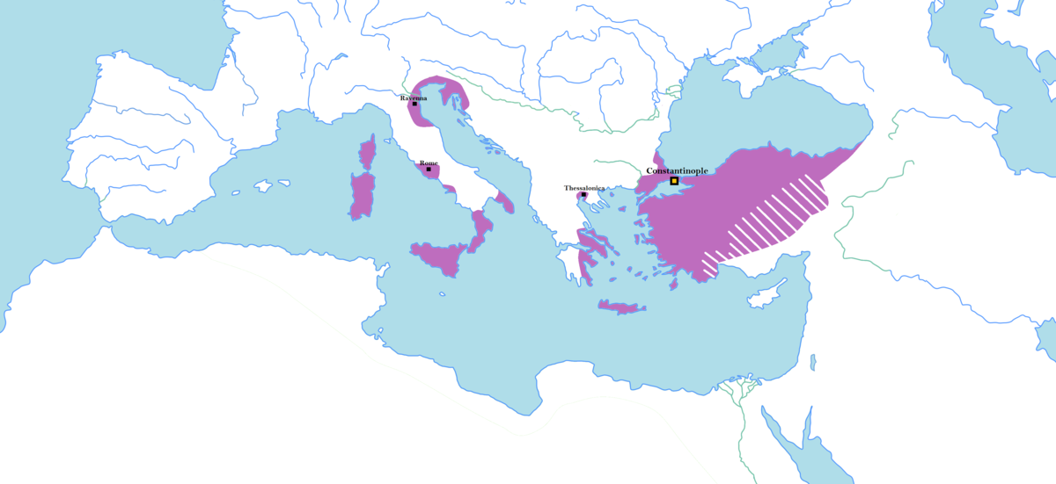
The Byzantine Empire, c.717 AD

Slide 4
The Byzantine Recovery
565-717 – Eastern Roman Empire under immense external pressure: Islam, barbarians: answer, a policy of internal reform/revolution:
  Made unofficial distinction between “core territories” – Constantinople, territory of modern Turkey, Africa, Mediterranean islands v dispensable peripheries – Egypt, Syria, Mainland Greece, Italy
  Stabilised silver coinage for first time since c.200 – more important for common people than gold
  Ended state-subsidised distributions of food in cities, plus lavish bathing complexes and general amenities of ancient urban life
  Ended use of Latin as official language – Greek from now on: no longer “Augustus et Imperator” etc, but “πιστός ἐν Χριστῷ βασιλεύς” (King, faithful in Christ)
  Began break-up of vast aristocratic land-holdings that kept perhaps majority of peasants as indentured tenants – replaced with inalienable grants of land in exchange for local military service
  Sought settlement of Monophysite controversy within core territories, paying no special attention to wishes of Pope
Heraclius I, 610-641 AD

Slide 5
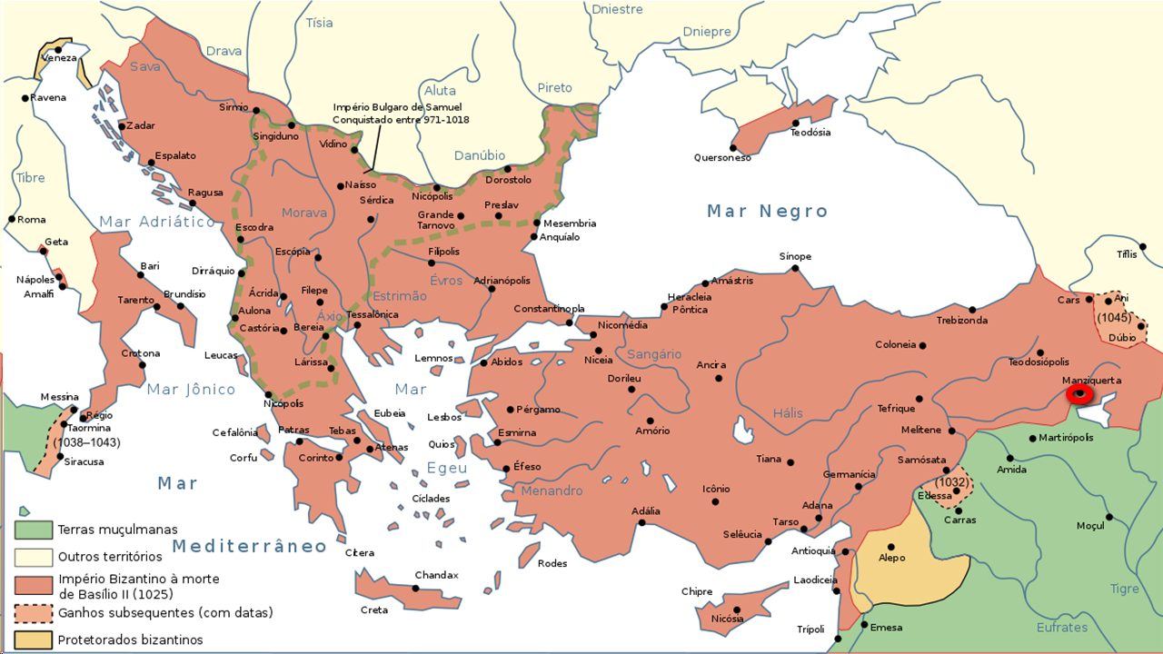
The Byzantine Empire, c.1025 AD

Slide 6
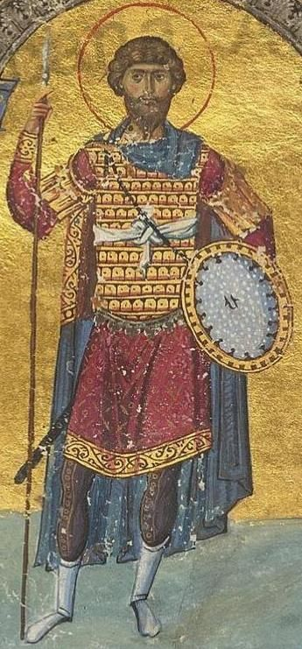
1025: Secure at Last
Basil II (976-1025) – The greatest of all the military Emperors during the long recovery since 717
Empire has doubled in size since the low point of the 8th century: probably also in population
Filled again with large and wealthy cities – Constantinople, Thessalonica, Thebes, Corinth, Antioch, etc
A hive of agriculture and commerce: an overflowing treasury: lowered taxes
An Age of artistic and literary greatness
An Orthodox Christian nation state at peace with itself
The Arabs humbled: the Bulgarians conquered: the Holy Roman Empire no longer a threat in Italy: head of an Orthodox confederacy reaching to the Arctic Circle
All borders secure – Empire surrounded by allies or satellites, or protected by geography
Basil II

Slide 7
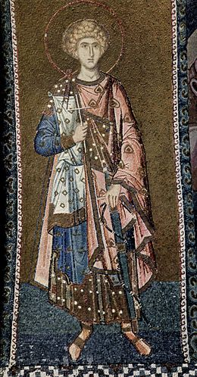
Internal Decay
Because no longer needed, successors of Basil neglect army and navy
Peasant militias allowed to commute military obligations with cash payments
Rise of new nobility since 9th century – emergence of family surnames: Phocas, Gavalus, Callerges, Comnenus, Ducas, Argyropoulos, etc – contrast with weak sense of genealogy in long Middle Period
Landed nobility largely indispensable for cultural renaissance – but hungry for land and power
Basil II and earlier Emperors ensure strict protection of peasant military tenures
But Basil leaves no son – nobility and bureaucracy cooperate to ensure half century of Imperial non-entities while they dominate prosperous and largely disarmed Empire: large armed forces seen as challenge to their own enrichment and security: reliance on mercenaries
General view of history as at an end – future will be an extended present of automatic Imperial hegemony

Slide 8
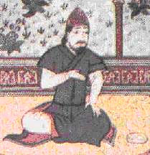
The Turks
Emerge into history in the 6th century – used as mercenaries by Empire
c.950 – Gradually convert to Islam: rise to positions of military importance in increasingly decadent Abbasid Caliphate
Seljuq and his descendants rapidly take over the core territories of the Abbasid Caliphate – 1055, grandson
Tughril captures Baghdad, establishing a new and expansionist power in the Islamic world
1071 – Alp Arslan invaded the Empire: a half century of peace and military
decay results in catastrophic defeat at Manzikert: Romanus IV himself taken
prisoner: conversation between the two rulers:
Alp Arslan: “What would you do if I was brought before you as a prisoner?”
Romanus: “Perhaps I’d kill you, or exhibit you in the streets of Constantinople.”
Alp Arslan: “My punishment is far heavier. I forgive you, and set you free.”
The sudden and radical collapse of the Empire as the hegemonic power in
the Near East
Pressed by Normans and Turks, Empire reducing to little more than
Constantinople and Greece
Alp Arslan

Slide 9
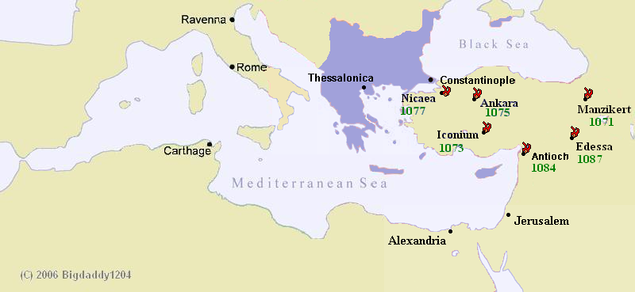
The Byzantine Empire, c.1071 AD

Slide 10
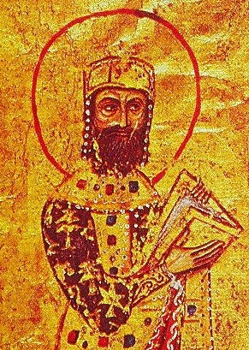
The Comnenian Restoration
1081 – Alexius Comnenus, aged 24, deposes Nicephorus III: Empire in state of collapse: debased coinage
Alexius establishes order in Constantinople and what is left of Empire – restores coinage – but constrained by powerful nobility and bureaucracy: Empire can only be saved in manner that does not endanger these very powerful interests
1082 – Alexius takes field against Norman invasion of Greece: uses alliance with Venice to bring about total defeat of Normans: also bribes Norman enemies in Italy: end of Norman threat after 1085
1095 – Turks still occupying Anatolian core territories: Alexius decides to recruit
Western mercenaries to assist in reconquest
Standard Imperial view of West – troublesome but often useful barbarians: obvious
step to play on common Christian faith to build temporary alliance against Turks
Formal letters of request sent to Pope Urban II and Count Robert of Flanders
Idea was to raise mercenary army under Imperial control
But the Empire has lost track of developments in the West
Alexius Comnenus

Slide 11
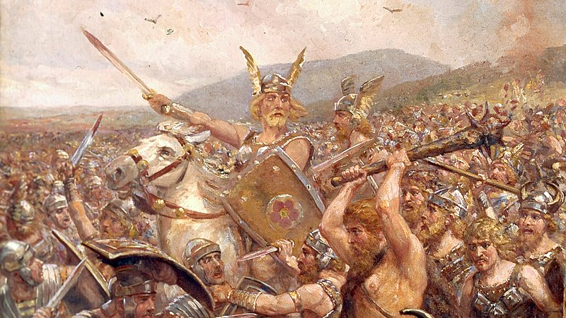

Slide 12
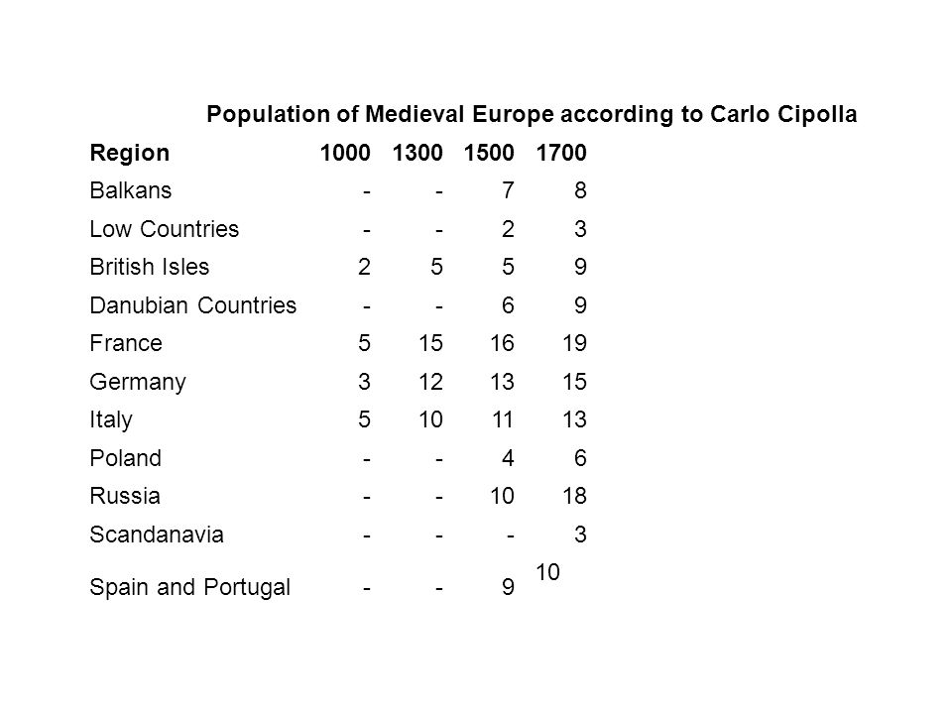
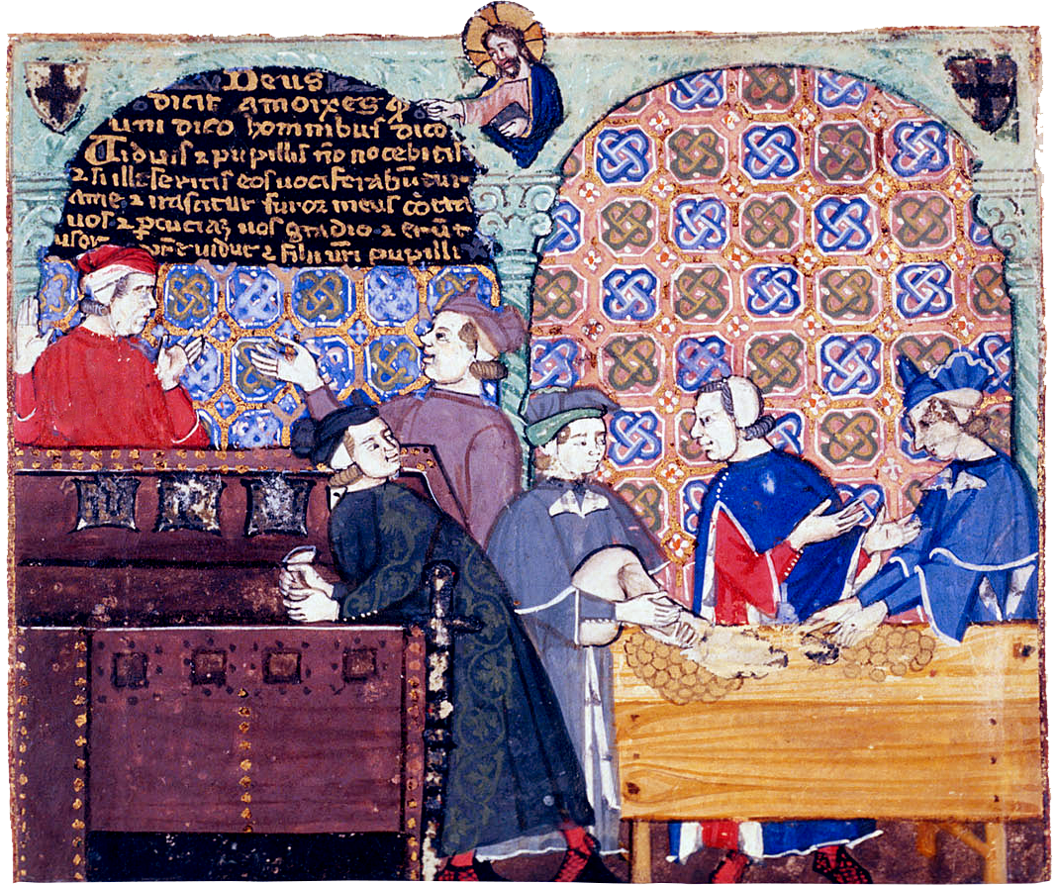


Slide 13
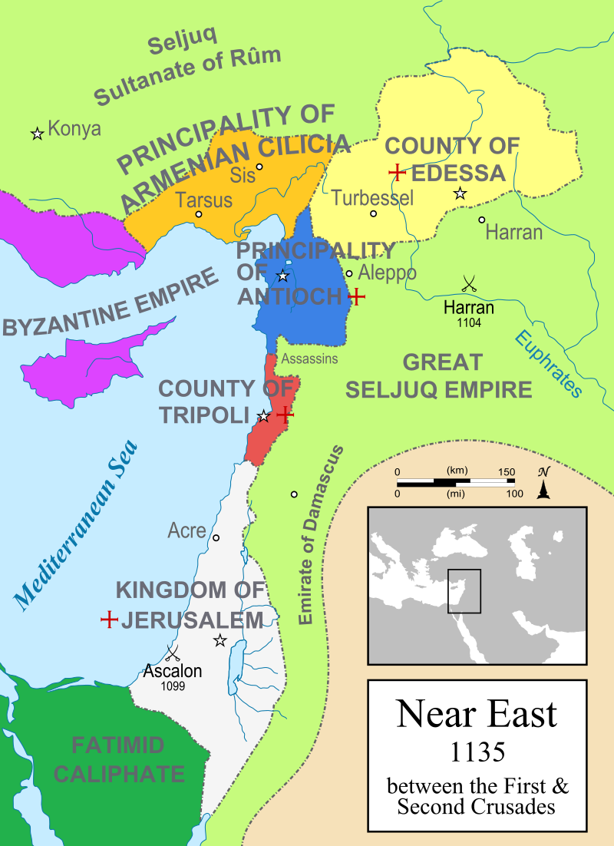
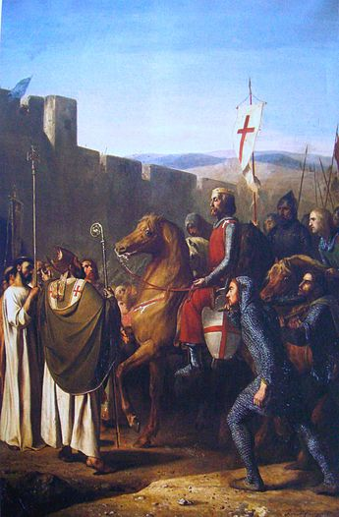
Baldwin of Boulogne entering Edessa in 1098 (Joseph-Nicolas Robert-Fleury 1840)

Slide 14
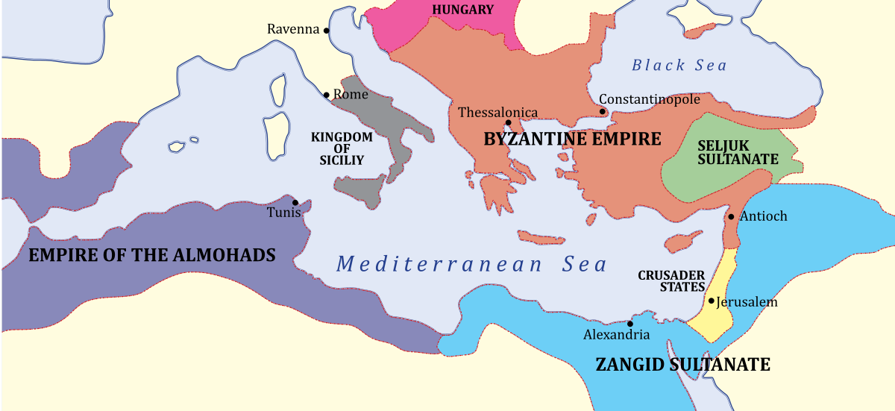
The Byzantine Empire, c.1180 AD

Slide 15
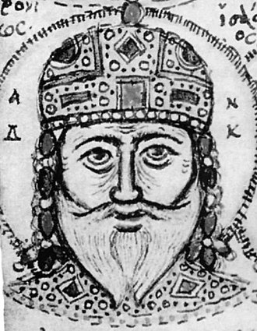
Andronicus
Breakdown sudden – 1176, Turks win battle of Myriocephalum: growing military collapse
1182 – Andronicus, a grandson of Manuel I, makes himself Emperor
His diagnosis of the Empire’s ills is that Italian traders have been given too many fiscal privileges and the landed nobility has engrossed too much land from the peasantry; and the administration has generally been captured by parasitic interest groups that have no regard for the Empire’s viability in the long term
Because of this, the tax base is shrinking: taxes are too high: pressures are
mounting on every border: the Empire is living on borrowed time
Andronicus response – a With-a-Bound-He-was-Free strategy
Mass-executions of the nobility and upper administration – followed by laws
against corruption and sale of offices: Executions even within Imperial Family
Massacre of Italian mercantile community in Constantinople
Andronicus breaks with all the now-ancient conventions against killing
political opponents

Slide 16
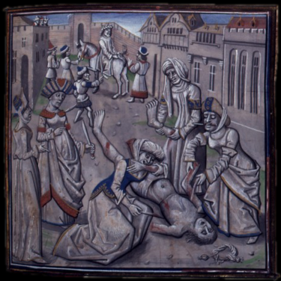
The Die is Cast
September 1185 – coup against Andronicus: tortured horribly to death over
three days
His laws repealed or ignored
Followed by Isaac II (1185-1204) – weak and largely in the pocket of the
restored Italian merchants
Imperial borders crumble – all gains of previous century lost, and even
Greece now a prey to Norman incursions
August 1203 – pro-Crusader Alexius Angelus crowned co-Emperor with Isaac: rioting breaks out in City
January 1204 – Isaac dies: another burst of rioting: Alexius deposed by Chamberlain Alexius Ducas – crowned as Alexius V: has Alexius Angelus strangled
Venetians ferrying Fourth Crusade to Egypt – diverted to Constantinople to avenge their dead ally and secure repayment of loans to him: Enrico Dandolo, Doge of Venice, takes personal charge of diverted Crusade
Venetians arrange for siege of City – ambition to take over tottering Empire for themselves

Slide 17
